Slide 1


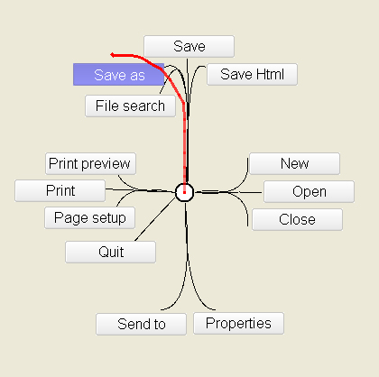
Flower Menus:
A New Type of Marking Menus with Large Menu Breadth, Within Groups and Efficient Expert Mode Memorization
Grenoble
France
Paris
France
Gilles Bailly
Eric Lecolinet
Laurence Nigay

Slide 2
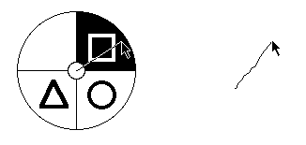
Introduction
Marking menus [Kurtenbach & al. 91]
Novice Mode
Expert Mode

Slide 3
Marking menus
Advantages
  Circular design
  Fluid Transition
  Eyes-free Selection
    Scale Independence
Novice Mode
Expert Mode

Slide 4
Marking menus
Limitations
  Limited number of commands
    Menu depth: number of levels (hierarchical Marking menus)
    Menu breadth: number of commands at each level

Slide 5
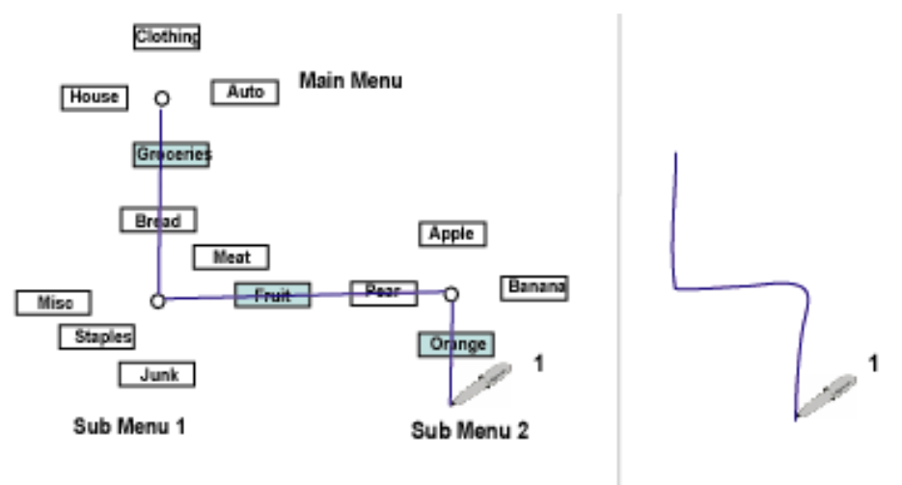
Depth: multi-level Marking menus
Limitation
  Error rate in expert mode
  Real estate requirement
Novice Mode
Expert Mode

Slide 6
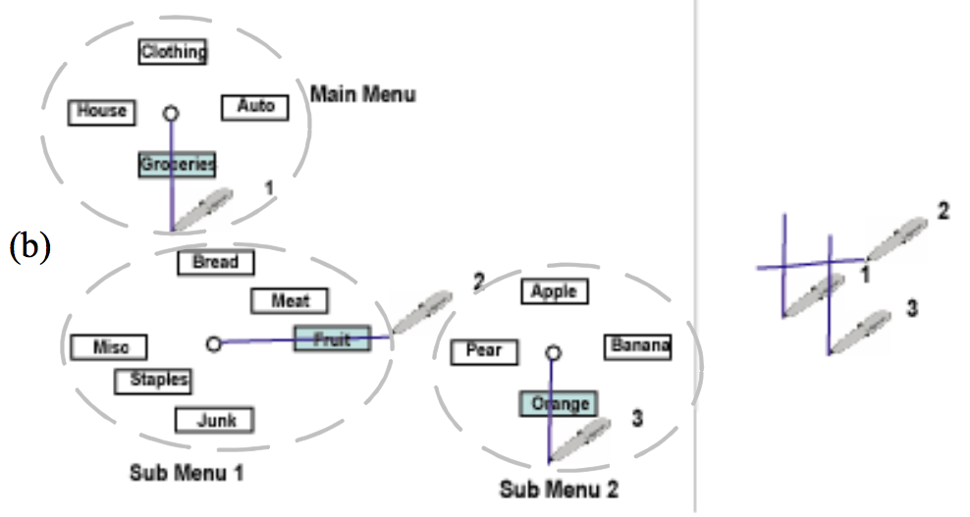
Multi-Stroke menus [Zhao 04]
Several simple marks instead of one complex mark
  Temporal instead of spatial composition
Less error prone
Marks can be overlapped
  Less amount of screen space
Novice Mode
Expert Mode

Slide 7
Marking menus
Limitations
  Limited number of commands
    Menu depth: number of levels (hierarchical Marking menus)
    Menu breadth: number of commands at each level

Slide 8
Problem
Number of commands at each level (menu breadth)

Slide 9
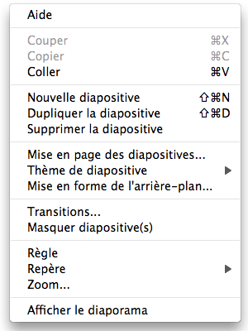
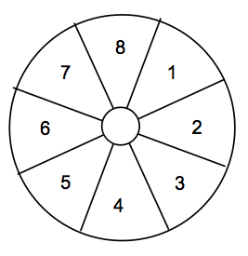
Menu breadth
Menu breadth
Limited to
8-12 commands
Context menu in PowerPoint
16 commands

Slide 10
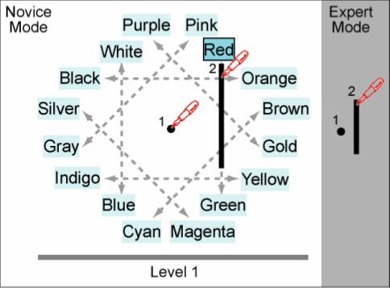
Polygon menus
Polygon Menus [Zhao & al. CHI’06]
16 commands

Slide 11

Polygon menus
Polygon Menus [Zhao & al. 06]
16 commands

Slide 12
Polygon menus
Tangential gestures
Radial Gestures
3 actions
  1 clic
  1 shift
  1 stroke
Specific layout
Polygon Menus [Zhao & al. 06]
Impact on learning and memorization

Slide 13
Outline
Introduction
Flower Menus
Experiment
Conclusion

Slide 14
Flower menus
Key features
  Large number of commands
  Within groups (groupings)
  Memorization

Slide 15

Flower menus

Slide 16
Large number of commands
Straight and curved gestures
  4 degrees of curvature

Slide 17
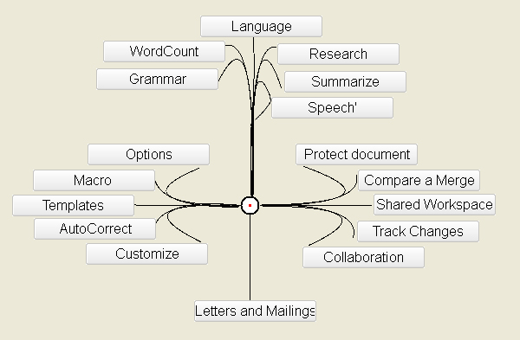
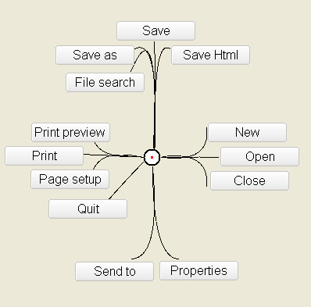
Degree of curvature
Save
Save as
File Search
Speech
Pigtail
Straight
Bent
Cusped

Slide 18
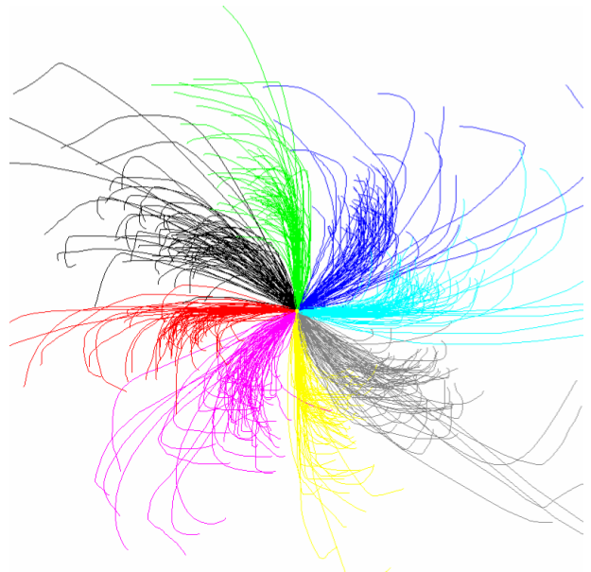
Pilot study
  Users could draw gestures precisely
  enough ?
  Answer: YES
Bias
  Higher variability on diagonals
specific gesture recognizer
  Takes into account user characteristics
  Recognition rate: 99% for common configurations
All Bent gestures for
the counterclosewise

Slide 19
Large number of commands
8 orientations
4 degrees of curvature
2 rotating directions ( Clockwise, counterclockwise )
For each menu level:
  Width potential: 56 commands
  But of course do not need that many

Slide 20
Distribution of the number of commands
Marking menus
Polygon menus
Flower menus
6 common applications:
Word, Excel, Adobe Reader, Firefox, Thunderbird, Photoshop

Slide 21
Flower menus
Large number of commands
Within groups (Groupings)
Memorization

Slide 22
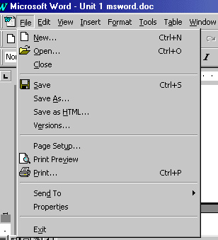
Within Groups (groupings)
Semantic groups at the same level
  Separated by a line
  No title
hierarchical groups
Improve visual search
The « File » Menu in Microsoft Word
5 within groups

Slide 23
Within Groups (groupings)
One within group by branch
One within group between
two separators

Slide 24
Distribution of the number of commands in within groups
Most within groups contain
1 or 2 commands
Flower menus
6 common applications:
Word, Excel, adobe reader, firefox, thunderbird, photoshop

Slide 25
Flower menus
Large number of commands
Within groups (groupings)
Memorization

Slide 26
Memorization
Improve learning and memorization
  Highlight semantic relationships
    Within groups
  Visual organization
    Proximity
    Closure (same branch)

Slide 27
Flower menus
Large number of commands
Within groups (groupings)
Memorization
Eyes-free selection
Hierarchical

Slide 28
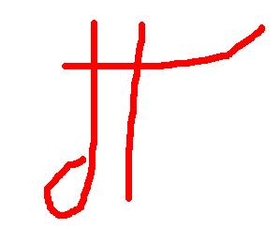
Multi-level Flower Menus
Flower menus work in the same way
as Multi-Stroke menus
  Several simple marks
  Overlapped marks
2-level Flower menus
  Potential: 56 * 56 > 3000
A 3 level Flower menus

Slide 29
Outline
Introduction
Flower Menus
Experiment
Conclusion

Slide 30
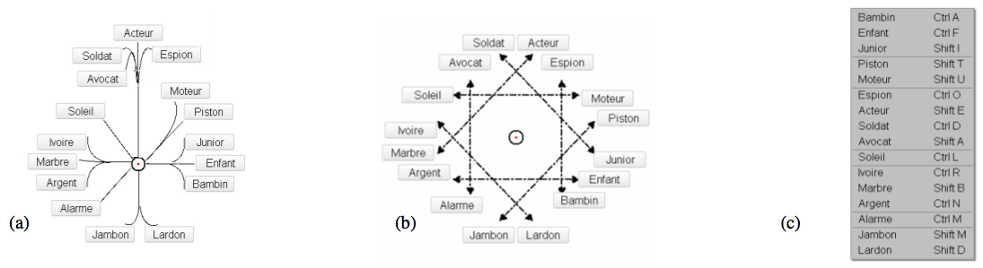
Experiment
Objective
  Learning performance of the expert mode of:
    Flower menus
    Polygon menus
    Linear menus (Base line)
16 commands in 7 within groups

Slide 31
Experiment
Intentional learning
  Users asked to learn the expert mode of the 16 items
Procedure
  Familiarization
  Training phase: from novice to expert mode
    Duration: 5mn
    Approximatively 2-3 selections for each command
  Testing phase: expert mode selections
    Stimulus : the name of the item

Slide 32
Summary
18 participants X
3 menu techniques X
16 commands (16 gestures in expert mode) X
2 repetitions
= 1728 selections
We measured how many items the users are able to select in expert mode.
- Number of items that are recalled

Slide 33
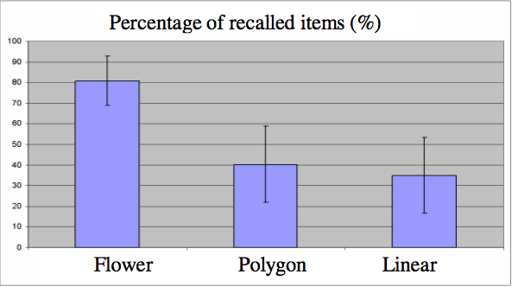
Results
81%
40%
35%
Flower two times better than Polygon
Surprisingly, performance of Linear close to Polygon

Slide 34
Possible explanations
Radial vs « tangential » gestures
In Polygon menus close items
can have very different gestures
User comments
  « difficult to recall the gesture while I know the position of the item »

Slide 35
Possible explanations
Marking menus efficiency
  Learn the expert mode by repeating the same gesture in novice mode.
Polygon v.s. Flower
  Both based on command repetition
  But quite different results
A simple expert mode
A simple mapping between commands and gestures

Slide 36
Subjective Preferences
17/18 chose Flower menus as their favorite technique
Best score for criteria:
  Familiarization
  Simplicity
  Learning
  Speed
  Accuracy
User comments
  They prefer « gestures starting from the center » with Flower menus
  rather than « having to perform two operations » with Polygon menus

Slide 37
Outline
Introduction
Flower Menus
Experiment
Conclusion

Slide 38
Conclusion
Flower menus
  Curved gestures added
  Support a large number of commands (20)
  Support within & hierarchical groups
  Favor learning and memorisation of commands
  Eyes-free selection, Scale Independence, Fluid Transition
Learning experiment
  Flower menus offer better performance than Polygon and Linear menus
  We gave some possible explanations

Slide 39
Future Work
Improve gesture recognizer
Study Implicit Learning
Compare with classical marking menus
  Breadth Organization vs Depth Organization
  Impact on learning performance

Slide 40
Thank you
Merci
Grazie
Video: www.gillesbailly.fr

